Slide 1
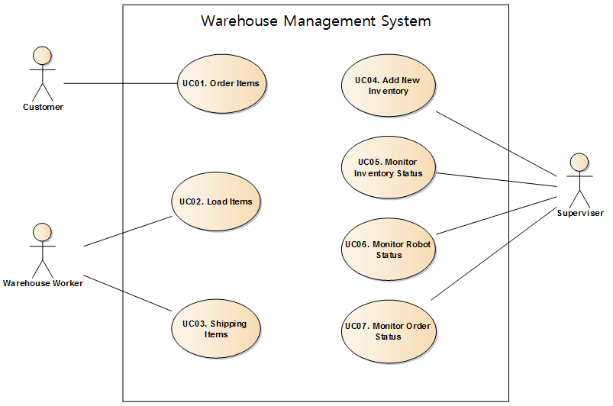
Use case text
Do-It-Yourself(DIY) User buys IoT System and IoT products at Home Depot. The user installs sensors and actuators at the proper place such like door, room, terrace and so on. Although the user doesn’t have any experience installing such devices, the user can install following user-manual. And user installs IoT software in own PC. And then user connects SA Node to Internet router and registers the node in IoT Software after log-in. After the registration, user checks sensors and actuators if they works or not. In addition, user makes a custom rule and puts it into IoT system. After all, user reviews sensors and command history.
??????????????
:System

Slide 2
Use Case Title : Query nodes and sensor/actuators | Use Case ID : UC-01
General use case description: This use case describes how to query nodes and sensors/actuators on each node information by user in a secure way
Entities involved: User / IoT Management System(IoTMS)
Preconditions User has registered in IoTMS using register menu
Primary use case flow of events: 1. User logs in IoTMS using by user’s ID and Password 2. IoTMS allows user to access System 3-1. User queries nodes information to IoTMS A. IoTMS returns number of nodes to User. B. User selects a node which user wants to know detailed information. C . IoTMS returns sensors/actuators information in the node to User. D. repeat B-C until user ends detailed query 3-2. User queries whole nodes information to IoTMS A. IoTMS makes list of nodes and sensor/actuators within node B. IoTMS returns list to User. 4. User logs out from IoTMS .
Primary use case post-conditions: User querying is completed
Alternate use case #3-1 1. It is possible to query malfunction nodes and sensors/actuators each node.
UC-01 Scenario: Query nodes and sensor/actuators
:IoTMS
:User
LogIn( ID,vPassword)
Allow access
Queries nodes information
Number of nodes
loop
[until user ends detailed query]
Selects a node
sensors/actuators information
of selected node
Request log out
log out

Slide 3
UC-02 Scenario: Add new rule
Use Case Title : Add new rule | Use Case ID : UC-02
General use case description: This use case describes how the system reacts by conditions previously defined
Entities involved: IoT Management System(IoTMS)
Preconditions User has logged in IoTMS . IoTMS manages the list of predefined rule sets.
Primary use case flow of events: 1. User adds a new rule with conditions and actions to IoTMS. 2. Check whether the condition is unique and no collision with registered conditions. 3. If no issue on the condition, IoTMS accepts and applies the rule to predefined rule set. 4. IoTMS displays added rule set to User.
Primary use case post-conditions: It is completed that new rule is inserted into predefined rules set.
Alternate use case #3-1 3.1. If the given condition is already existing or collision with other rules, IoTMS invokes error message with the reason.
:IoTMS
:User
AddNewRule(condition, action)
Check rule condition
Register/display new rule

Slide 4
UC-03 Scenario:
Review histories of sensors/actuators state and user commands
Use Case Title : Review histories of sensors/actuators state and user commands | Use Case ID : UC-03
General use case description: This use case describes how to review user’s sensor and command history by user in a secure way
Entities involved: User IoT Management System(IoTMS)
Preconditions User has registered in IoTMS using register menu
Primary use case flow of events: 1. User tries to log in IoTMS using by user’s ID and Password 2. IoTMS allows user to access System 3. User requests sensors or commands history to IoTMS 4. IoTMS checks that user has permission 5. IoTMS asks period of history what user want to review to user 6. User sends period what user want to review 7. IoTMS makes list of history what user want 8. IoTMS displays list of sensors and commands history to user
Primary use case post-conditions: User Reviewing history is completed
Alternate use case #5-1 5.1. If User cannot login because of incorrect ID/password, IoTMS displays “Find Password” or “Find User-ID” for User
:IoTMS
:User
LogIn( ID,vPassword)
Allow access
sensors / commands history to IoTMS
Check user permission
Ask period of history
period of history
Display history

Slide 5
UC-04 Scenario: Test control/monitor
Use Case Title : Test control/monitor | Use Case ID : UC-04
General use case description: This use case describes how to test control/monitor sensors/actuators after log-in
Entities involved: Secure service
Preconditions User has already logged in IoT Management System(IoTMS).
Primary use case flow of events: 1. User tries to log in IoTMS using by user’s ID and Password 2. User monitors the temperature/humidity. 3. User turns on indoor light. 4. User turns on outdoor light. 5. User turns off indoor light. 6. User turns off outdoor light. 7. User controls door close. 8. User controls door open. 9. User monitors door sensors. 10. User monitors presence/proximity sensor.
Primary use case post-conditions: User logs out to finish access the server.
Alternate use case #1-1 1.1 If user inputs wrong ID or password, system informs log-in fail.
:IoTMS
:Node
:User
LogIn( ID,vPassword)
Allow access
temperature/humidity
temperature/humidity
temperature/humidity
temperature/humidity
Turn on/off light
Turn on/off light
close/open door
close/open door
door sensor status
door sensor status
Door is open/close
Door is open/close
proximity sensor
proximity sensor
Human is at home/away
Human is at home/away

Slide 6
UC-05 Scenario: Register node
Use Case Title : Register node | Use Case ID : UC-05
General use case description: Server register node.
Entities involved: Installer, User(Customer), Server, Node
Preconditions Server and node have same serial key.
Primary use case flow of events: 1. Installer or user request register node to server. 2. Server search node. 3. Server display node that can be registered. 4. Installer or user select node. 5. Server register the selected node.
Primary use case post-conditions: Server and node can communicate with each other.
Alternate use case 3.1 if there is no node, display nothing. 3.2 if there is registered node, indicates that registered nodes
:IoTMS
(server)
:Node
:User/Installer
LogIn( ID,vPassword)
Allow access
Register node
Search node
Node information
Display node information
Select node
Register node
End register
Accept register

Slide 7
5.1.3 Publish-Subscribe Pattern
We send messages to each other via the Event bus(Publish-Subscribe Pattern) module to enhance decouping between the major modules of IoTMS.
.
Promoted Quality Attributes | Description
Flexibility | The SW defect is easily modified for each module because each module will have been decoupling in Event bus.
Testability | It is easy to test each module because each module will have been decoupling in Event bus.
maintainability | The SW debugging is easier for each module because each module will have been decoupling in Event bus.
Promoted Quality Attributes | Description
Performance | The Publisher of event bus broadcast all subscriber. So each subscriber should filter unwanted messages to itself. However, if many SA Nodes are added to IoTMS and the message sent from the node increases , the overall message throughput is reduced.

Slide 8
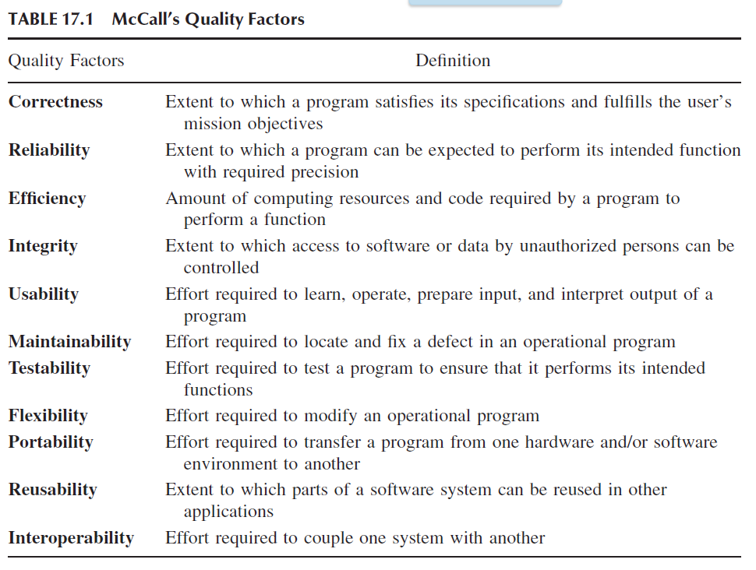
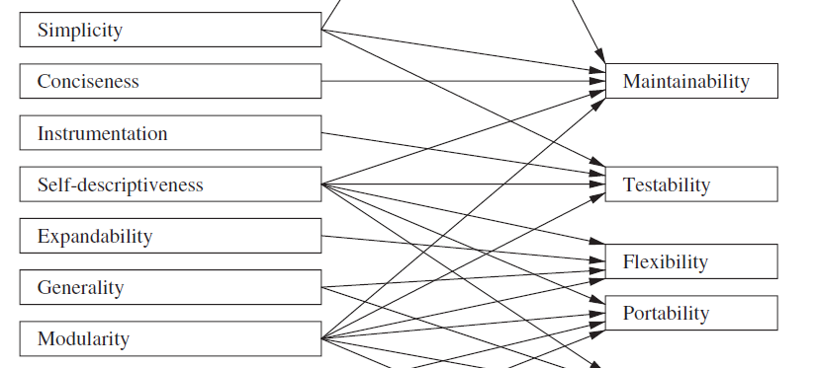
NaikSoftwareQuality(1).pdf
Maintainability: In general, maintenance refers to the upkeep of products
in response to deterioration of their components due to continued use
of the products. Maintainability refers to how easily and inexpensively
the maintenance tasks can be performed. For software products, there are
three categories of maintenance activities: corrective, adaptive, and perfective.
Corrective maintenance is a postrelease activity, and it refers to
the removal of defects existing in an in-service software. The existing
defects might have been known at the time of release of the product or
might have been introduced during maintenance. Adaptive maintenance
concerns adjusting software systems to changes in the execution environment.
Perfective maintenance concerns modifying a software system to
improve some of its qualities.
Testability : It is important to be able to verify every requirement, both explicitly
stated and simply expected. Testability means the ability to verify
requirements. At every stage of software development, it is necessary to
consider the testability aspect of a product. Specifically, for each requirement
we try to answer the question: What procedure should one use to
test the requirement, and how easily can one verify it? To make a product
testable, designers may have to instrument a design with functionalities
not available to the customer.
BCK page 167
Having high cohesion, loose coupling, and separation of concerns— all modifiability tactics (see Chapter 7)— can also help with testability.

Slide 9
5.3 Dynamic Perspective 메모[민연P5116]
5.3.1 Dynamic View of overall
UI
User DB
Log DB
e-mail
twitter
Rule DB
User Interface Manager
Log Manager
Message Manager
Rule Manager
A
B
: JSON event , from A to B
A
B
E v e n t B u s
: information, from A to B
A
B
: WiFi (TCP/IP) , from A to B
Communication
Manager
Node Manager
DB
1…*
Manager
1…*
Thing object
(Sensor, actuator...)
Node
Node
Node object
Link
Communication module
(Wifi, bluetooth…)
……
Things object List
rule thread object
actuators
sensors
Default
sensors
Home
Team2
Smart
mail box
50th
SA node
actuators
sensors
Default
sensors
SA node (Arduino)
……
user access

Slide 10
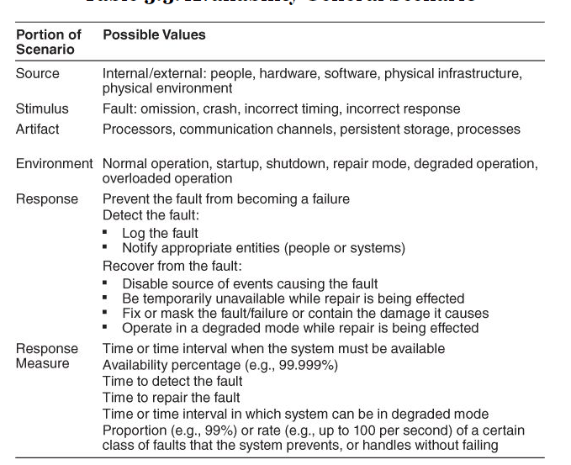
Scenario Title: Availability | Scenario ID: QA-01
Raw Quality Attribute Description: | Sensors availability
Source of Stimulus: | Sensors
Stimulus: | Sensor failure , sensor malfunction
Environmental Condition | Normal operation , The IoTMS has been installed and it works.
System Element: | • Sensors • IoTMS
System Response: | If a sensor value is not between normal range, the IoTMS recognizes malfunction or fault of sensors. And then the IoTMS sends alarm message to user. (The normal values ranges are configured according to sensor datasheet.)
Significant Measures: | The IoTMS sends alarm message to user in 10 seconds after recognizing malfunction or fault of sensors in 3 times consecutively.

Slide 11
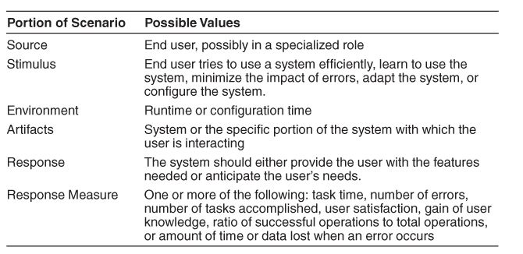
Scenario Title: Usability | Scenario ID: QA-02
Raw Quality Attribute Description: | UI(User Interface) Usability
Source of Stimulus: | User
Stimulus: | User tries to use IoTMS.
Environmental Condition | User configuration time IoTMS run time The user has logged into the IoTMS.
System Element: | UI of IoTMS
System Response: | When the user wants to change the settings of IoTMS or to get sensor value or to set actuator, the usage of UI should not be complicated.
Significant Measures: | UI depth is less than 3.

Slide 12
Scenario Title: Scalability | Scenario ID: QA-03
Raw Quality Attribute Description: | SA Nodes Scalability
Source of Stimulus: | User( Installer, DIY user ..etc. )
Stimulus: | Add another SA Nodes
Environmental Condition | IoTMS has one SA node.
System Element: | IoTMS , SA node
System Response: | When the user wants to add two or more SA node to their own IoTMS, 1. Install additional SA node at the home. 2. IoTMS find & connect additional SA Node on network. 3. complete.
Significant Measures: | IoTMS allow up to 50 SA Nodes.

Slide 13
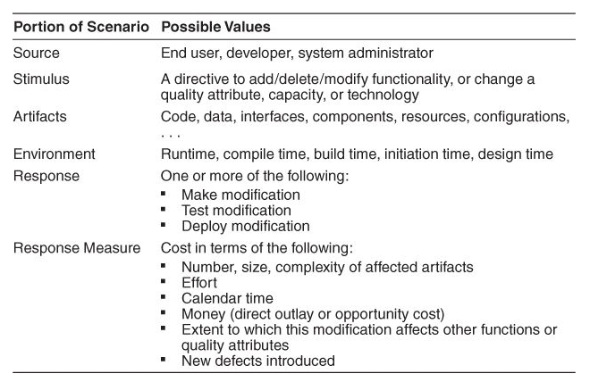
Scenario Title: Modifiability | Scenario ID: QA-04
Raw Quality Attribute Description: | communication protocol Modifiability
Source of Stimulus: | developer , 3rd party vendor , …etc
Stimulus: | new communication protocol between IoTMS and SA node
Environmental Condition | Current IoTMS communicate with SA node using WiFi only. New communication moldule’s compile time , build time
System Element: | Communication manager of IoTMS
System Response: | Emerging new protocol, SW developer make/test/deploy new communication protocol module.
Significant Measures: | Emerging new protocol, it is possible to be developed in 2 man-months.

Slide 14
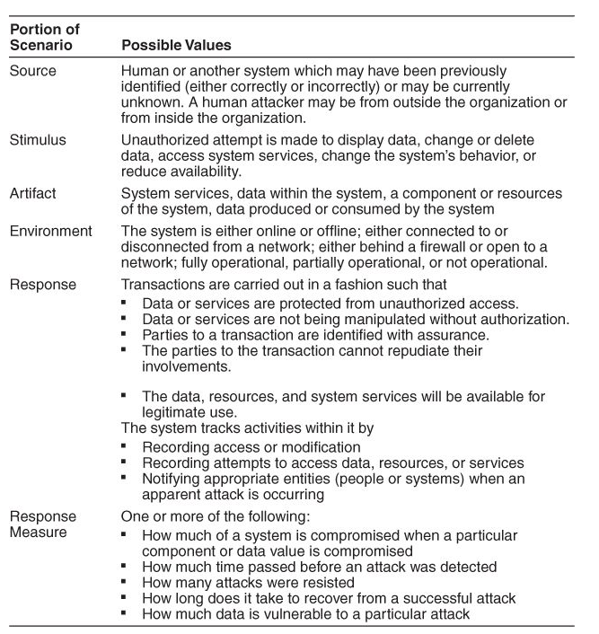
Scenario Title: Security | Scenario ID: QA-05
Raw Quality Attribute Description: | User access Security
Source of Stimulus: | unauthorized user
Stimulus: | unauthorized user tries to access IoTMS
Environmental Condition | IoTMS is online. IoTMS has a list of authorized users.
System Element: | IoTMS
System Response: | If the user is not in the list and tries to access to IoTMS , IoTMS dosen't allow login.
Significant Measures: | IoTMS never allow unauthorized user to access.

Slide 15
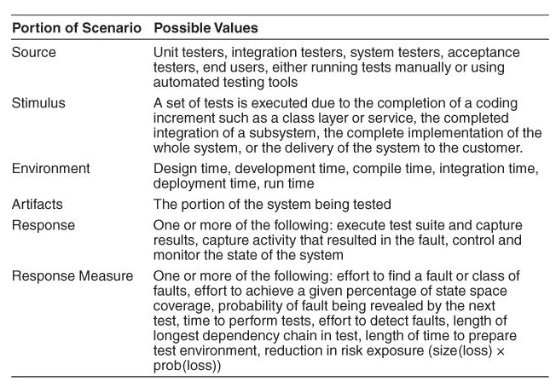
Scenario Title: Testability | Scenario ID: QA-06
Raw Quality Attribute Description: | SW module Testability
Source of Stimulus: | Test engineer , Test manager.
Stimulus: | SW module Test
Environmental Condition | SW module development time SW module integration time SW module deployment time SW module run time
System Element: | SW module of IoTMS SA node
System Response: | Test engineer test the quality of the software based on the test case , capture the results , feedback to the developers.
Significant Measures: | The 80% of test cases can be tested within 1 day.

Slide 16
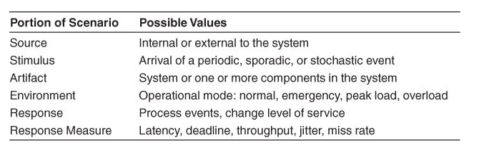
[민연P511]???
Scenario Title: Performance | Scenario ID: QA-07
Raw Quality Attribute Description: | IoTMS-SA node Response time Performance
Source of Stimulus: | User
Stimulus: | User's direct request to SA node.
Environmental Condition | normal operation mode of IoTMS
System Element: | IoTMS SA node
System Response: | When the user request to get sensor value, 1. IoTMS send the "get sensor value" message to SA node . 2. SA node measure sensor value. 3. SA node send "sensor value" message to IoTMS. 4. IoTMS display "sensor value". When the user request to set actuator status, 5. IoTMS send the "set actuator status" message to SA node. 6. SA node set actuator. 7. SA node send "complete actuator control" message. 8. IoTMS display "actuator status".
Significant Measures: | The response time of controlling(System Response 5~8) and monitoring(System Response 1~4) SA node is within 10 seconds.

Slide 17
Scenario Title: Availability | Scenario ID: QA-08
Raw Quality Attribute Description: | Logging history availability
Source of Stimulus: | Disk space
Stimulus: | The logging module fails to work when the disk space is full .
Environmental Condition | Normal operation : Logging module is logging history to Disk .
System Element: | Log Manager (SW) Disk (HW)
System Response: | IoTMS detect and notify Disk Full to administrator
Significant Measures: | Detect and notify Logging failure in 30 seconds by IoTMS

